Slide 1



Sprout City Tech
Rebecca Nielson
&
Alondra Macias
Sprout City Tech LLC.

Slide 2
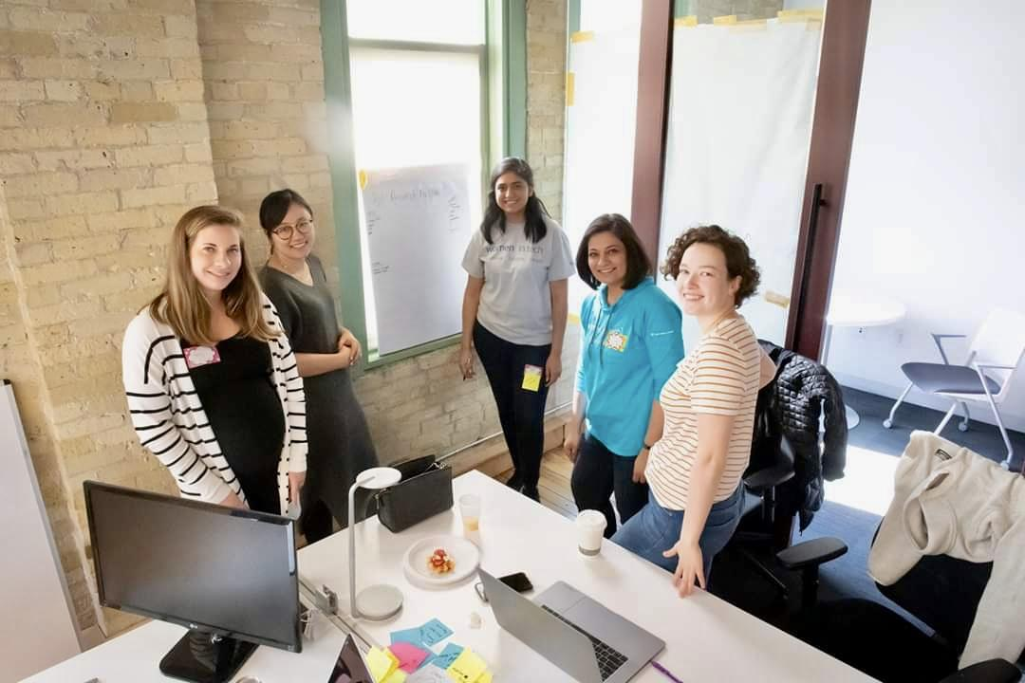
Sprout City Tech LLC.

Slide 3

FOR|M
Sprout City Tech LLC.

Slide 4
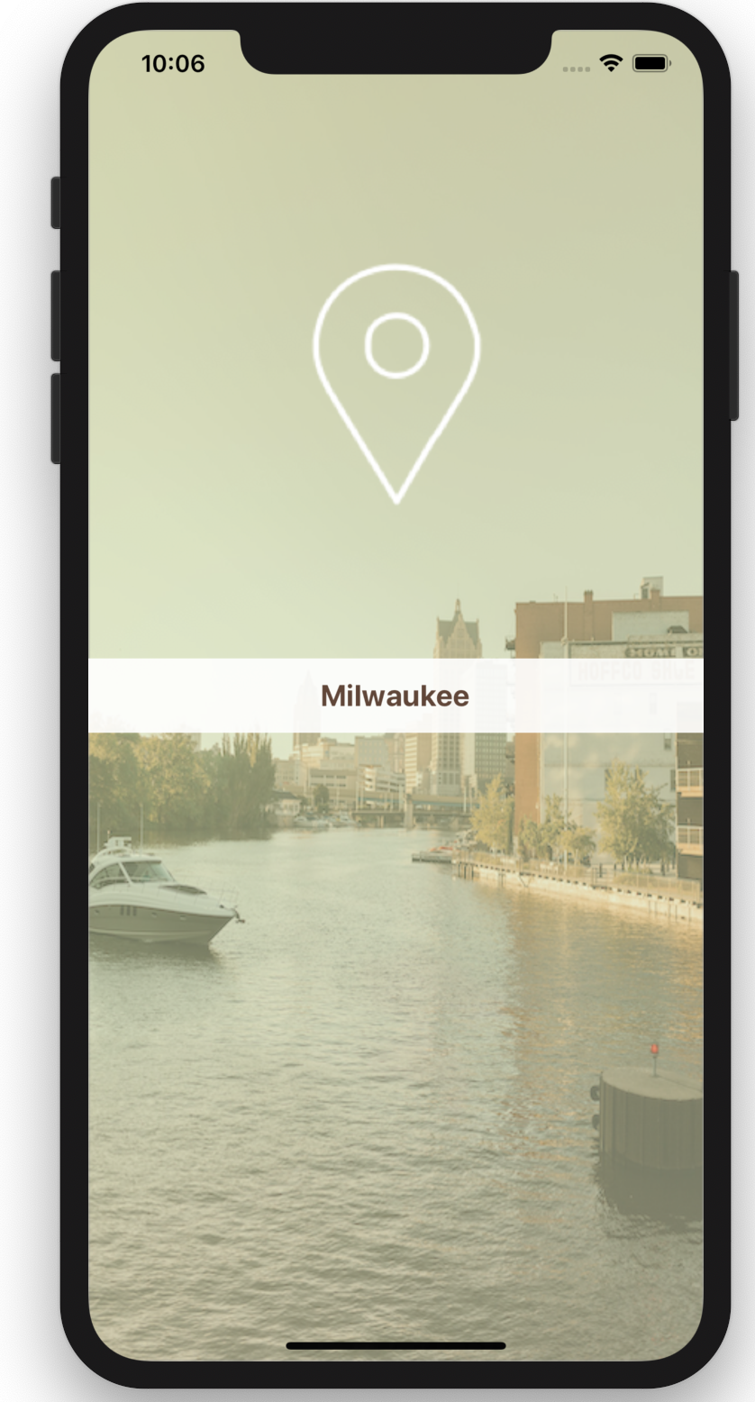

Google Search
Yelp Reviews
Local Tourist Sites
Google Maps
Random Blogs
Trip Advisor
Social Media
Hop/Bublr/Bus schedules
Sprout City Tech LLC.

Slide 5


Sprout City Tech LLC.

Slide 6
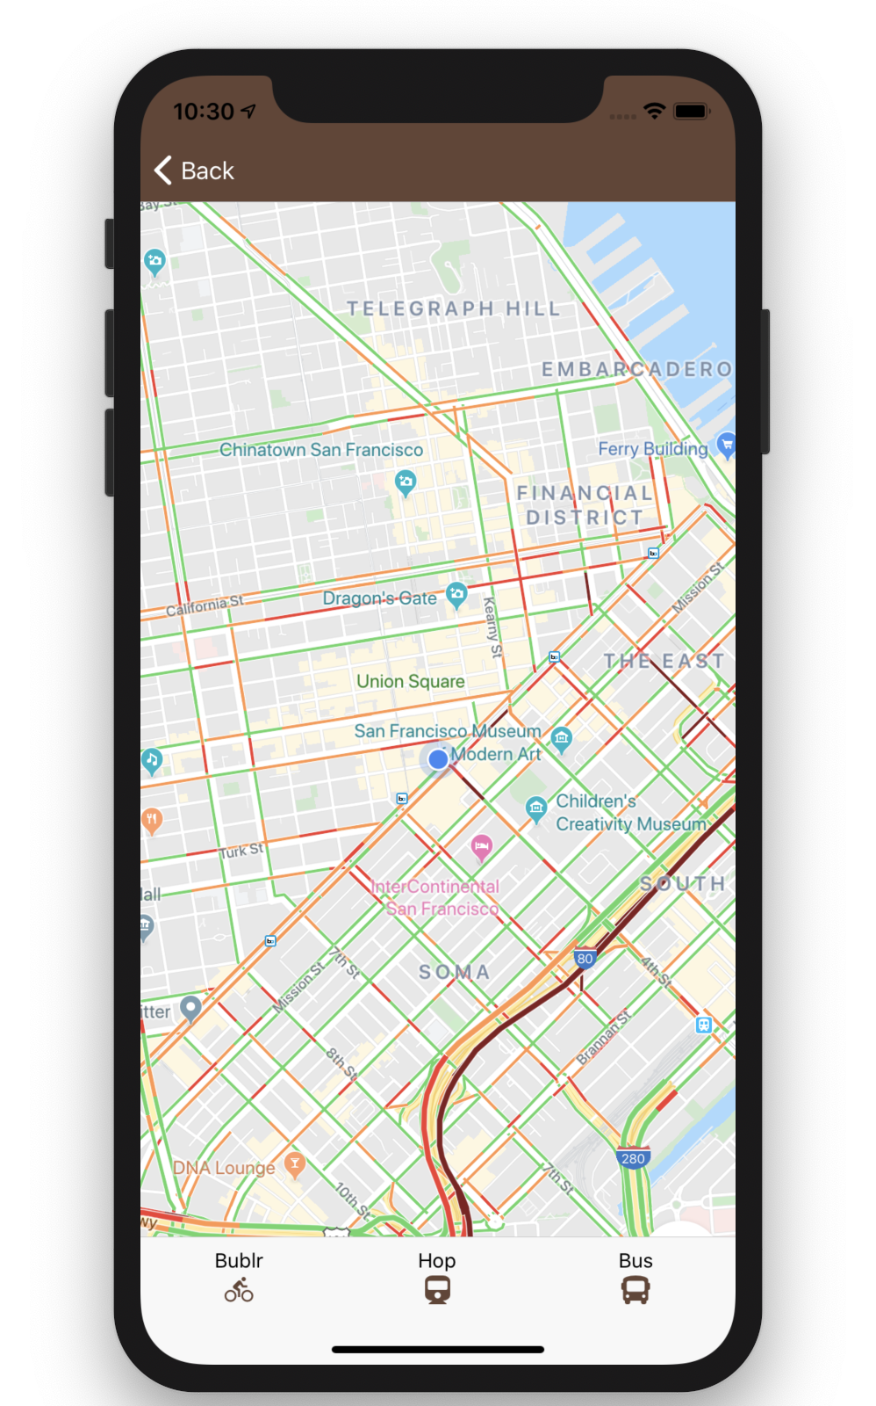
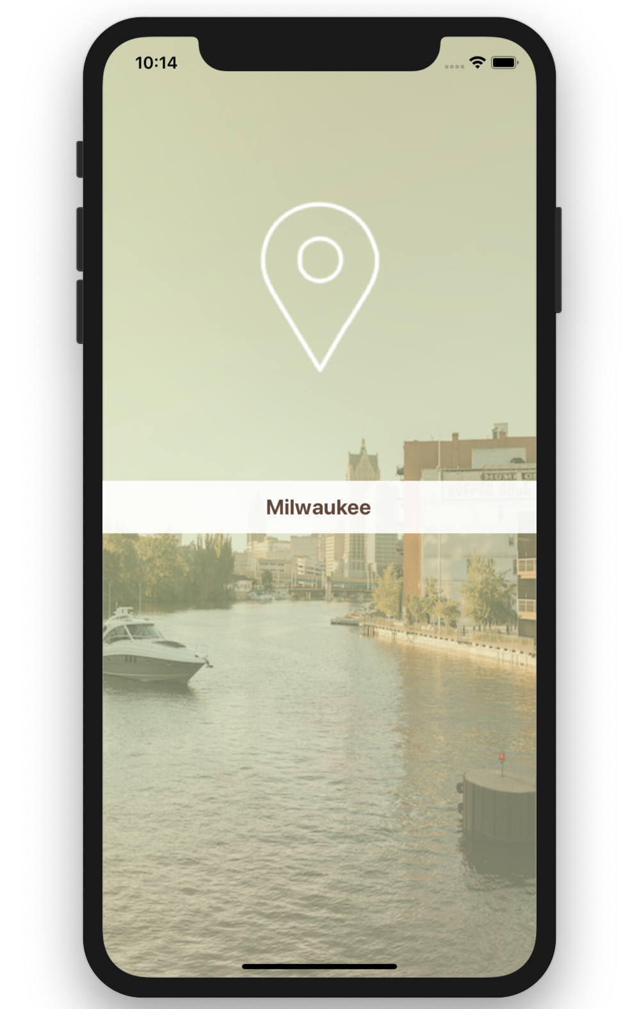
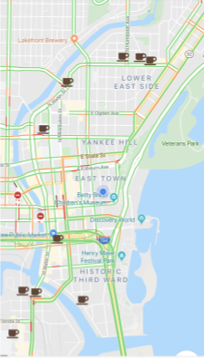
Sprout City Tech LLC.

Slide 7
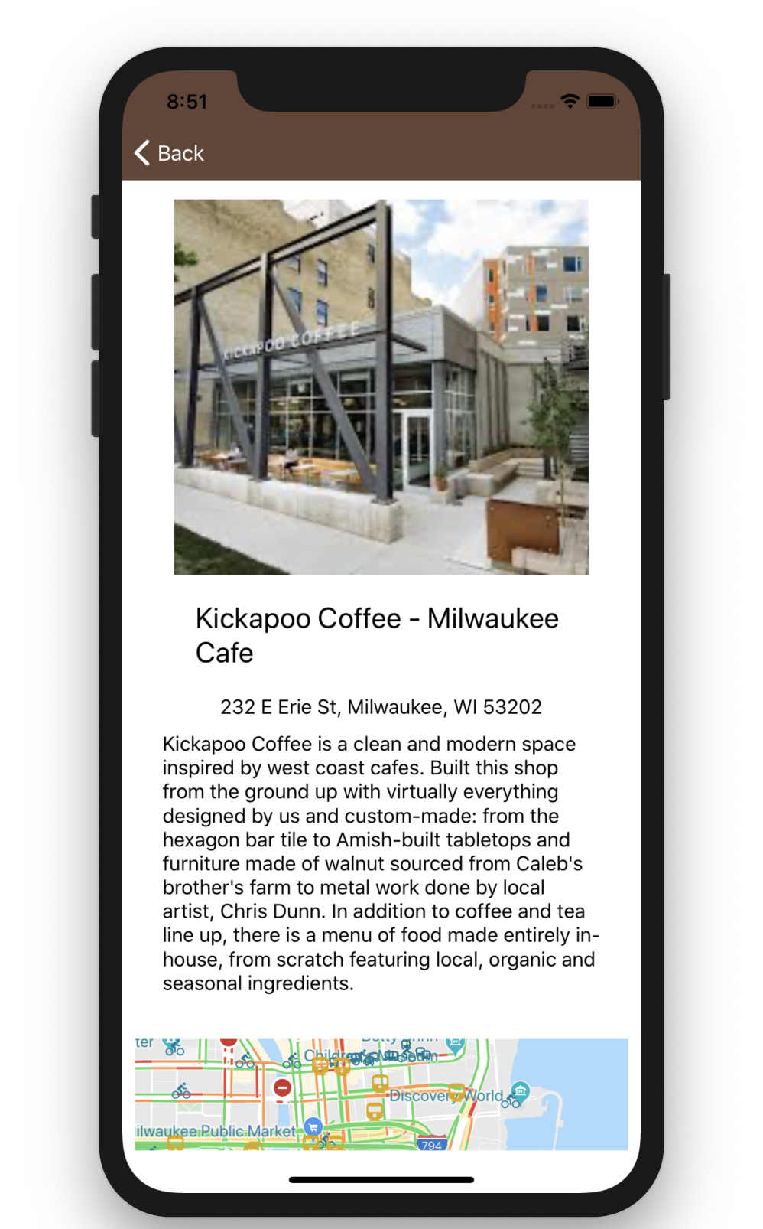
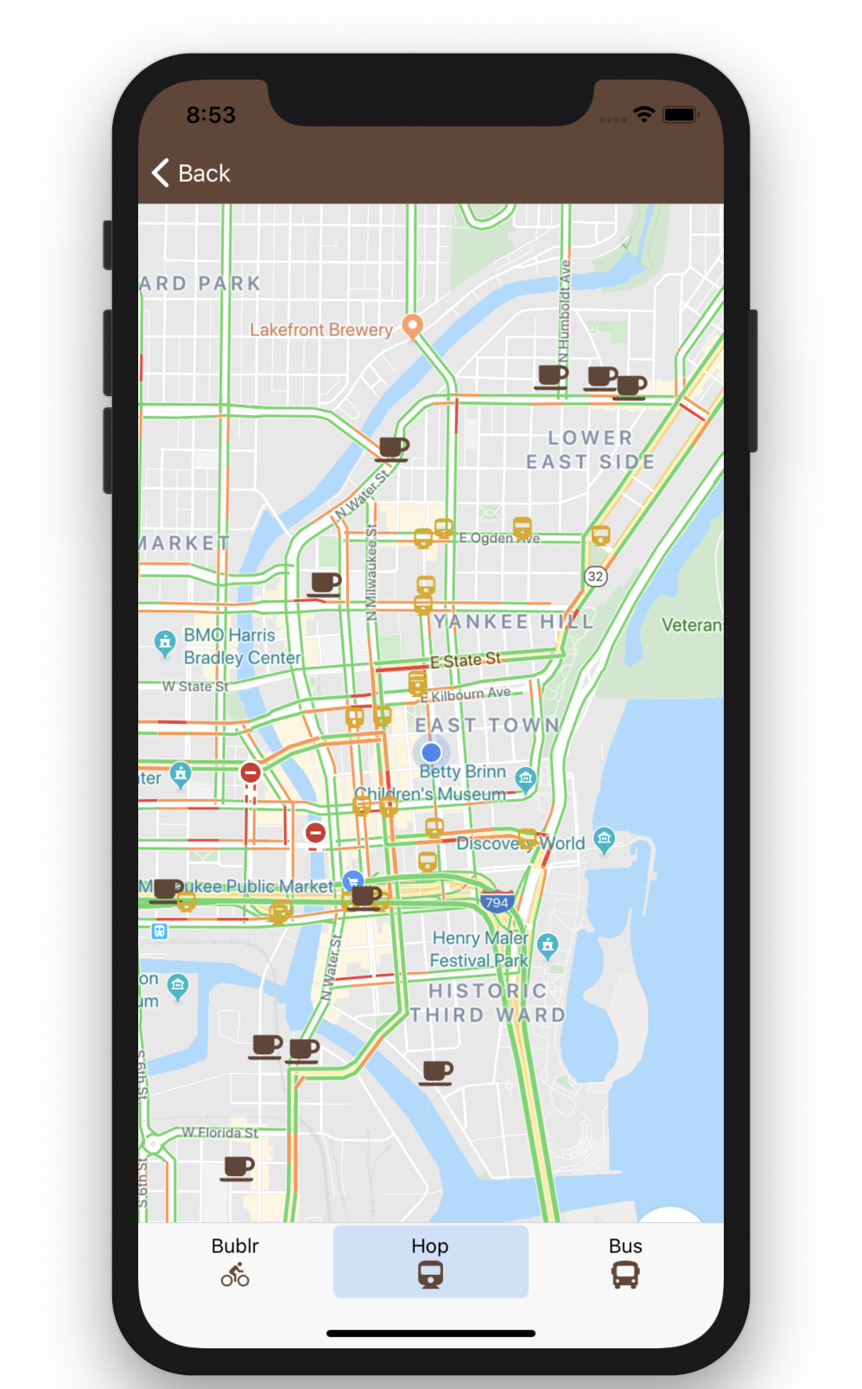
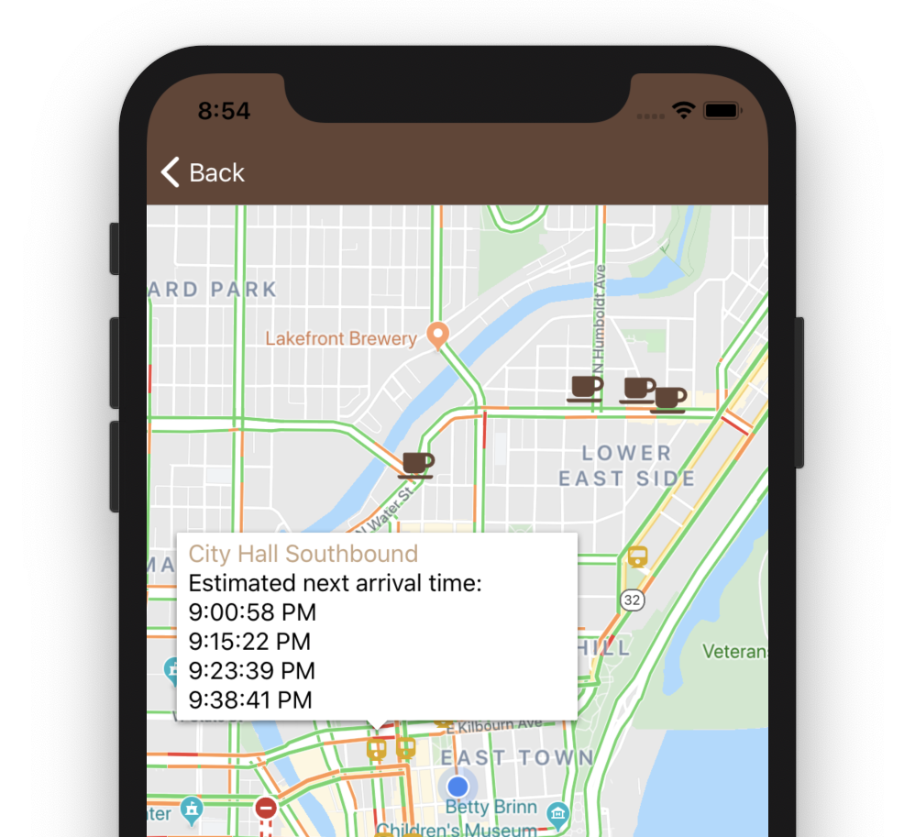
Sprout City Tech LLC.

Slide 8
City Data API’s Used
Hop
Bublr
Buses
(In Progress) Bird Scooters

Slide 9
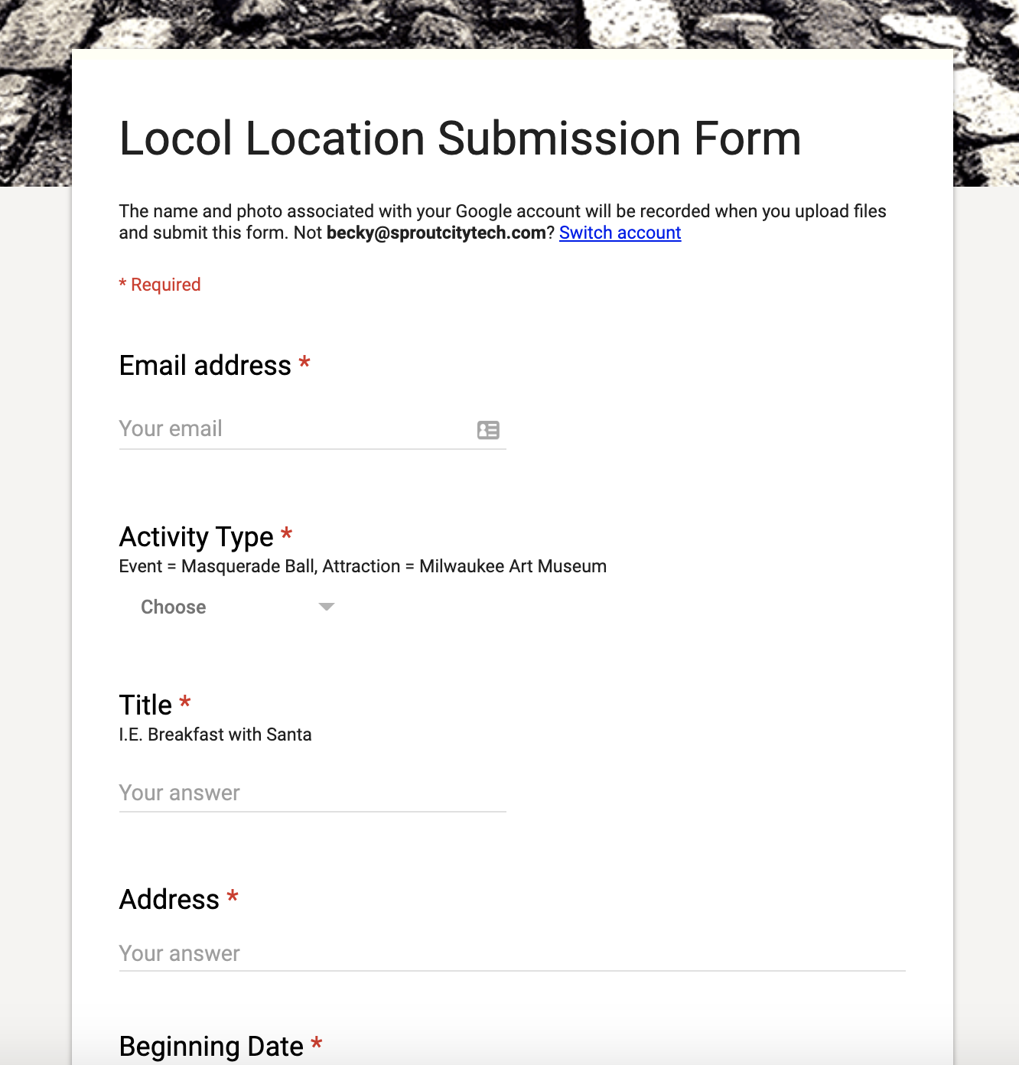

Slide 10

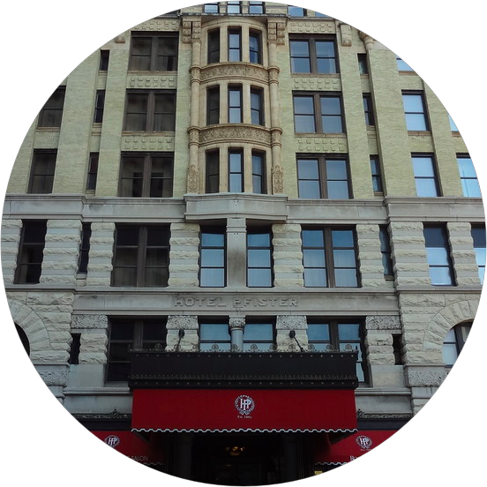

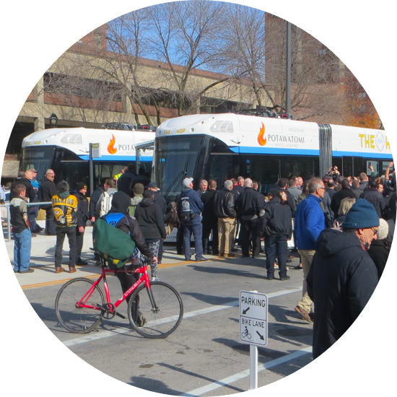
Lessons Learned
Sprout City Tech LLC.

Slide 11



Sprout City Tech LLC.

Slide 12





Sprout City Tech LLC.

